Slide 1
Research Project Workshop 06:
Citation Management
May 17, 2017
Instructor(s): Stephanie Kerns, MLS & Letisha Wyatt, PhD

Slide 2
learning outcomes
1 Understand the basic function and utility of
citation management software
2 Set-up and important citation information
into an application on your computer
3 Utilize 1-2 key features in EndNote
4 Identify ways to overcome access issues
that may effect collaboration workflows

Slide 3
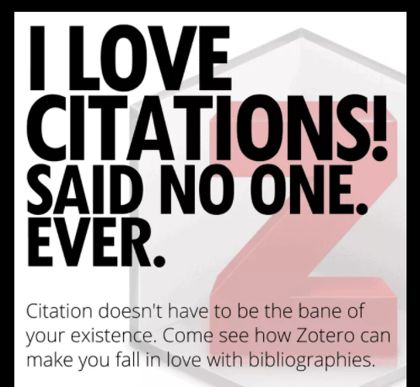

Slide 4
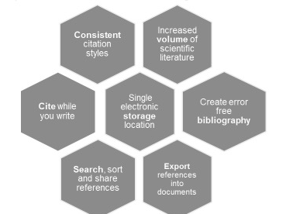

why bother with citation manager?
Image Sourced from Here

Slide 5
citation management ”lifecycle”
database
citation manager
word processing app

Slide 6
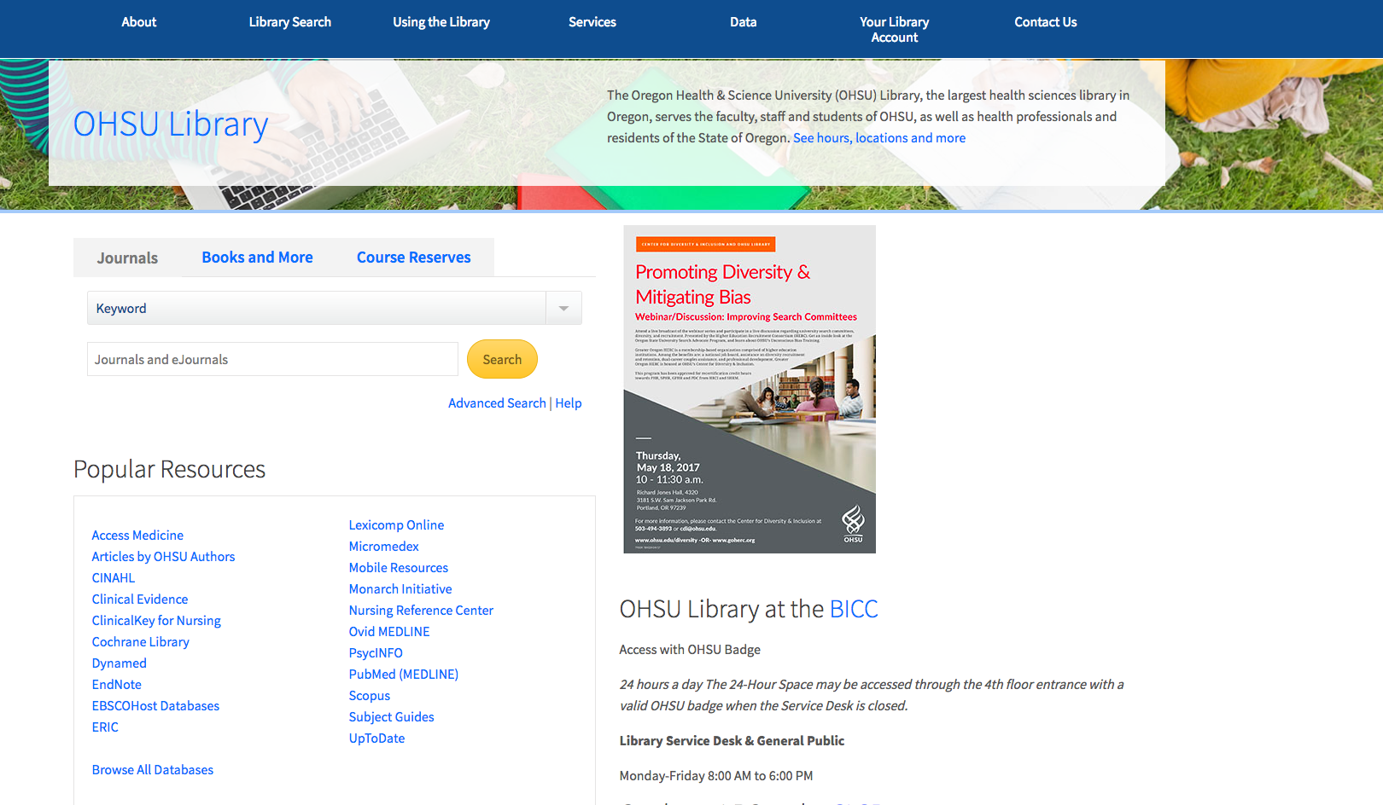
OHSU Library databases
Notes:
Review – EXTERNAL databases

Slide 7
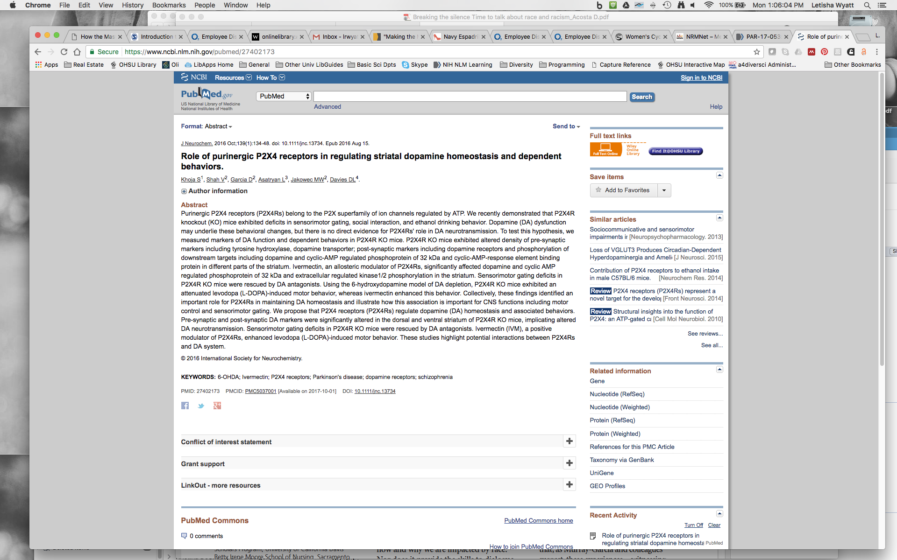
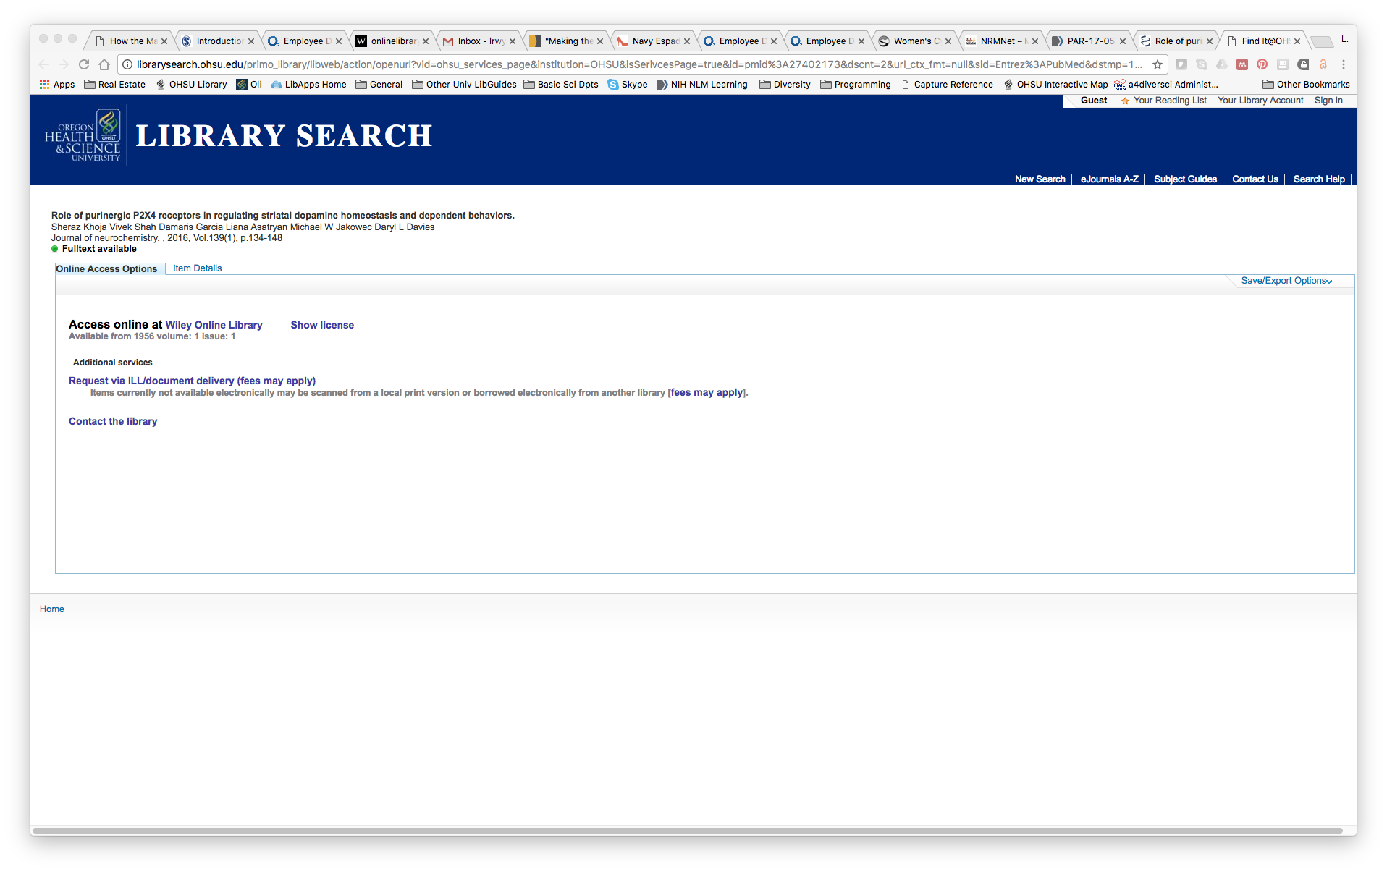
Library Search
Notes:
Review - Library catalogue is our INTERNAL database
connect Medline db (or other) with library catalogue by always stating at OHSU Library home page

Slide 8
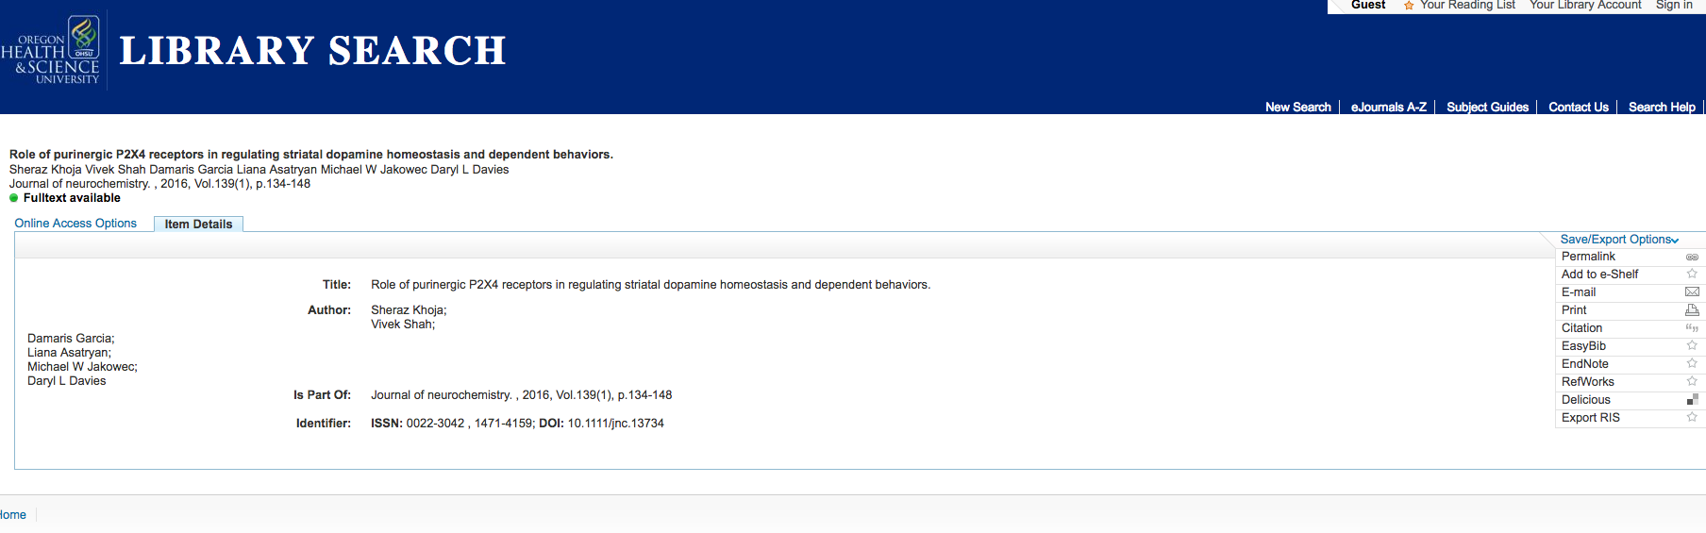
database -> citation manager

Slide 9
citation management ”lifecycle”
database
citation manager
word processing app

Slide 10
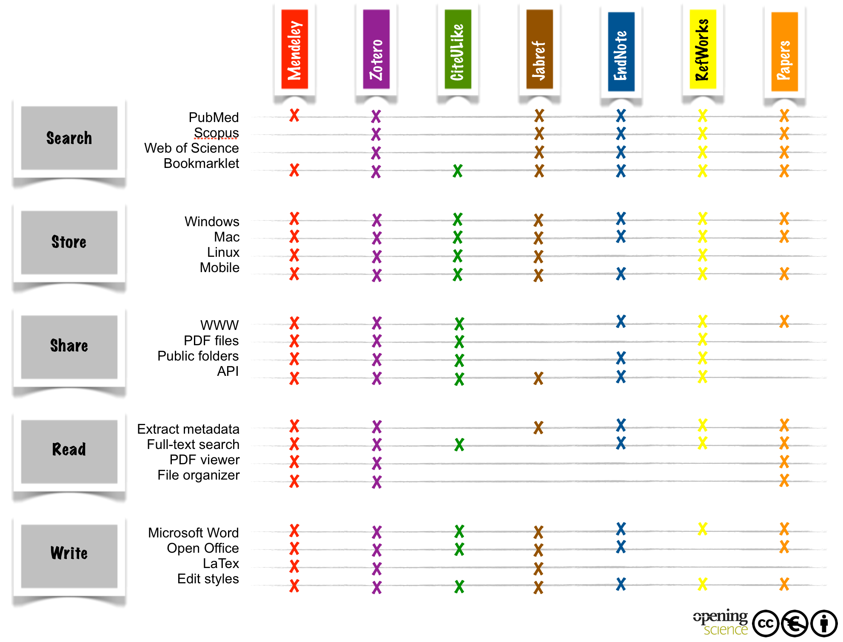
citation management
free version
X
X
X
X
X
Notes:
helpful guide!
http://book.openingscience.org/tools/reference_management.html

Slide 11
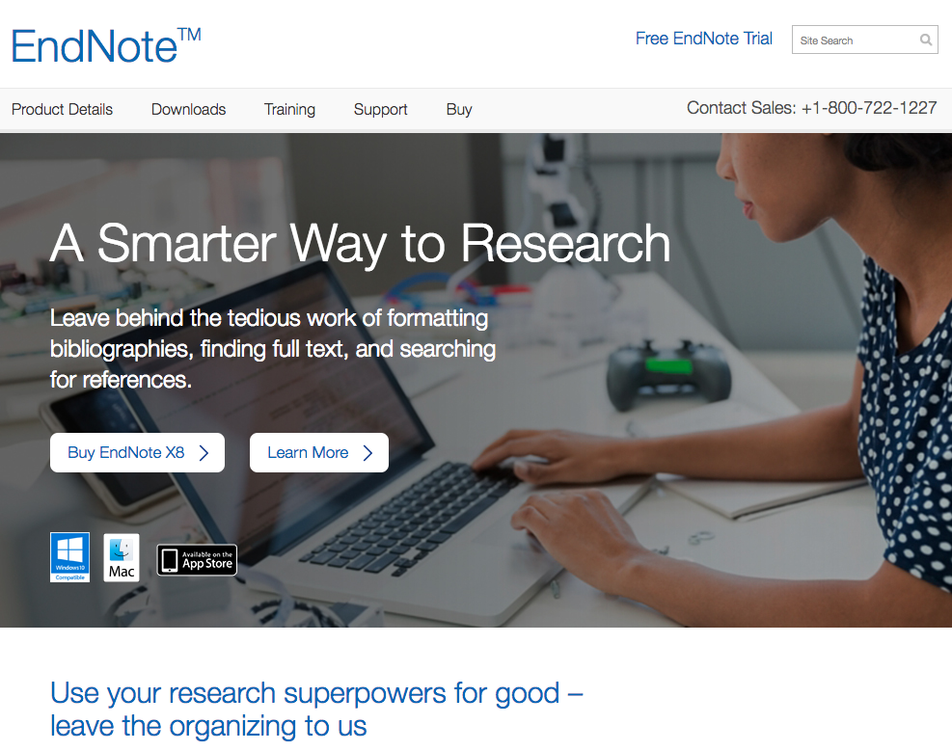
Notes:
What is EndNote
How to get it (show Libguide?)

Slide 12
EndNote best practices
Only create one master library
Keep your .enl and .data folder together
These should live on your hard drive (do not sync from the cloud)!
Back-up your library (compressed copies are great!)
Select terms lists for most complete citation information
Find duplicates before you start writing!
Write/share text in “unformatted citations” mode

Slide 13
EndNote key features
Set up EndNote web account for sync/share features
Create records by importing citations & PDFs
Organize your citations into “Groups”
Attach files of any type (great for co-locating datasets
Find full text
Easy updates to Bibliographies (http://endnote.com/downloads/styles)
Export traveling libraries

Slide 14
Going off road….
Notes:
EndNote live demo

Slide 15
Institutional Access Sticking Points
Notes:
thinking about being on campus and working with folks who are not at OHSU…
Also for yourselves if you migrate away from OHSU

Slide 16
word processing options
Microsoft Word
OHSU’s Microsoft Home Use Program - $10
Google Docs
LaTex
Markdown documents (plain text files)
Notes:
Should have access beyond OHSU!

Slide 17
citation management
options
free version
X
X
X
X
X
Notes:
When you leave OHSU, you will still have access to EndNote web (free) and the installed software
point out that these all work with EndNote

Slide 18
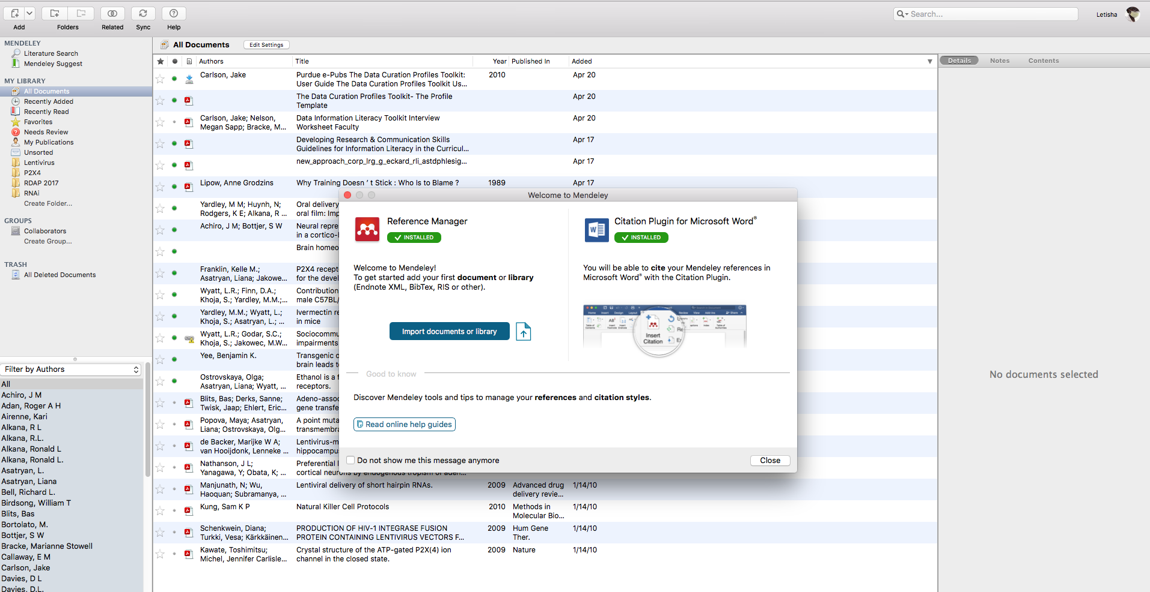
Mendeley
Notes:
Be proactive about what tool you use and when you will use it (can import EndNote library)
Unique features:
EndNote provides ID specific to individual libraries, Mendeley serves as a communal (web-repository) so collaboration is a little more seamless

Slide 19
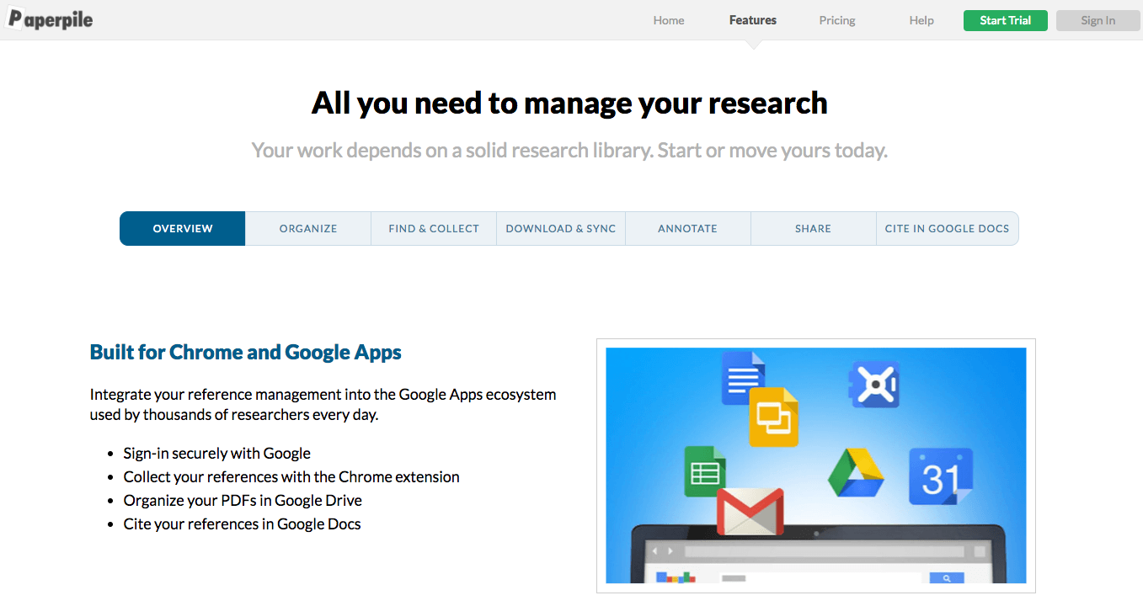
paper pile
for google docs
Notes:
web-based citation management application
not free but may be worth it if heavy use/collaboration in google docs ($3/mo, billed annually at $36)
the only tool for google docs that builds bibs like EndNote does (demo: https://paperpile.com/features/google-docs-citations-bibliography)

Slide 20
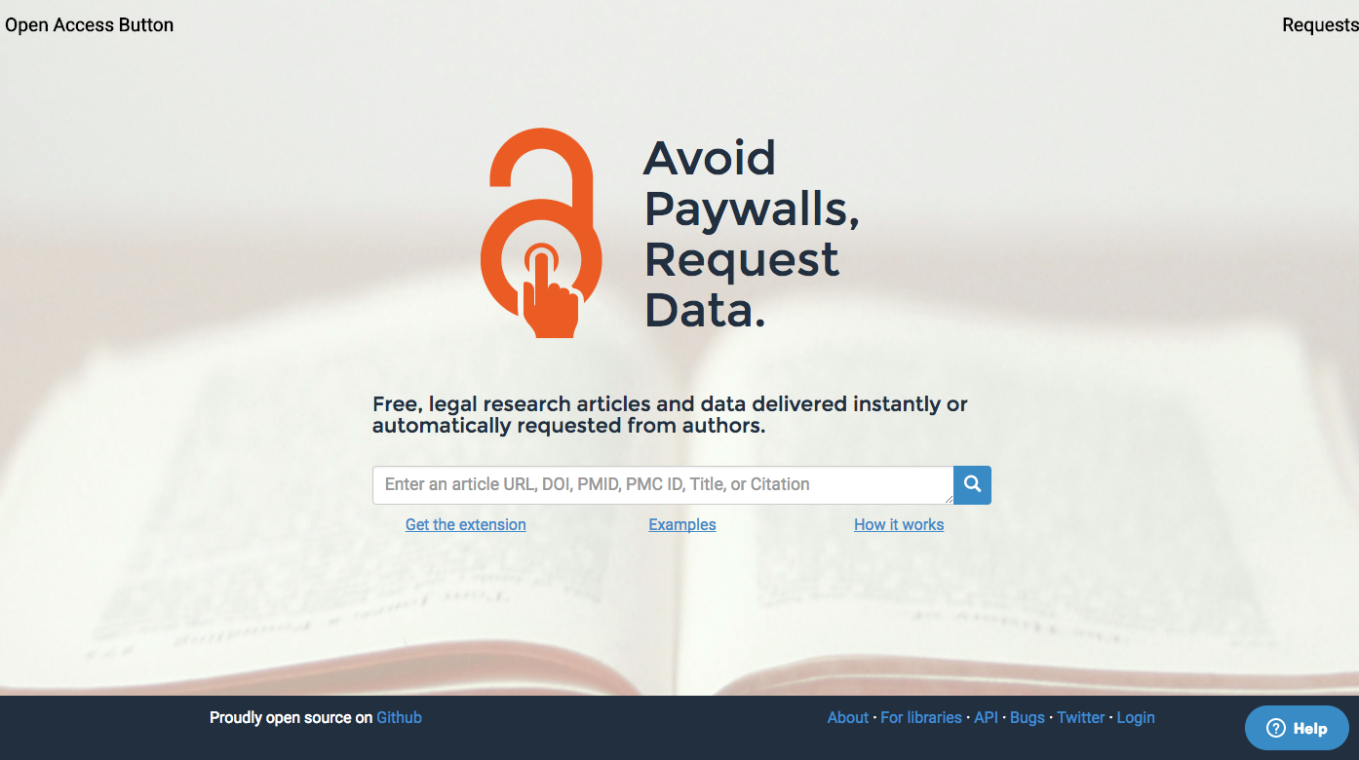
find free full text
Open Access Button: openaccessbutton.org
Notes:
the original (since 2013)
The Open Access Button is supported by SPARC (Scholarly Publishing and Academic Resources Coaltion).
web extension
also aids in finding datasets!
like to brag that code for making this work is on github so that anyone can use/modify/contribute!

Slide 21
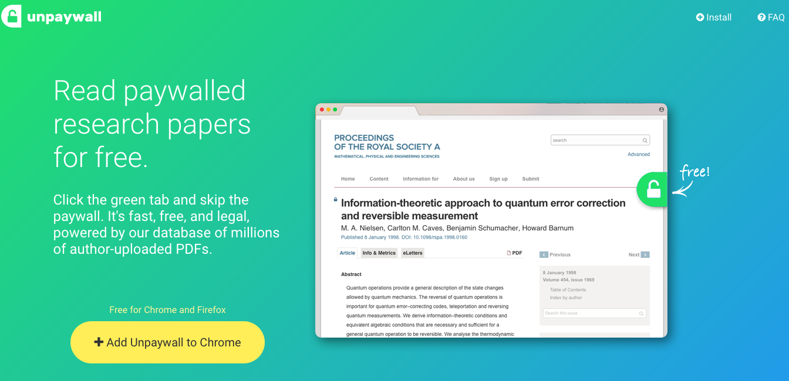
find free full text
Unpaywall: unpaywall.org
Notes:
web extension
managed by ”Impact Story” – we’ll talk more about them in the scholarly communication workshops
Supported by NSF and Sloan Foundation
green tab on “65-85% of articles”

Slide 22
how does this work?
Author (legally) supplies the manuscript to an online repository for sharing
This plug in, combs the web to find the article
If it’s not available, a request is made to the author to share their work – within copyright law (in the case of Open Access Button)
Acquired papers placed in Zenodo
Acquired data placed on the Open Science Framework
Notes:
Remember we talked about pre-prints/open science framework some time ago?

Slide 23
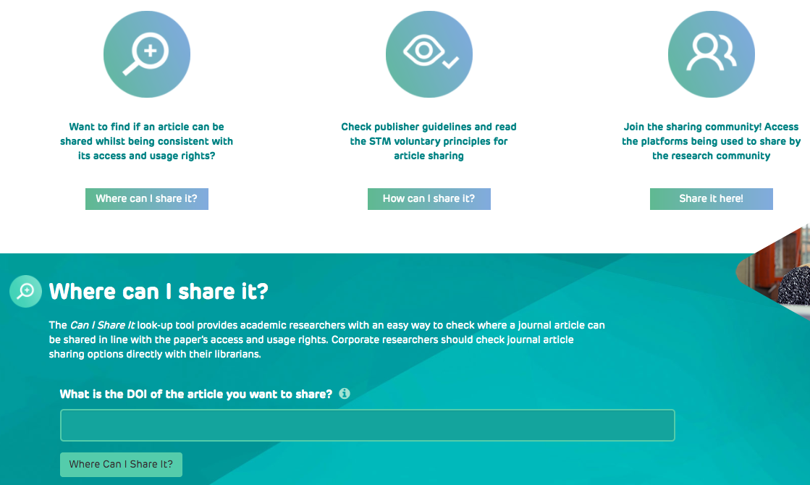
...about sharing published work!
How Can I Share It?: howcanishareit.com
Notes:
testing: 10.1016/j.neuropharm.2012.03.014

Slide 24
recap
1 Understand the basic function and utility of
citation management software
2 Set-up and important citation information
into an application on your computer
3 Utilize 1-2 key features in EndNote
4 Identify ways to overcome access issues
that may effect collaboration workflows

Slide 25
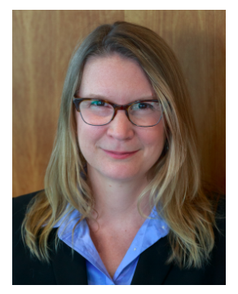


key resources
EndNote LibGuide: http://libguides.ohsu.edu/endnote
EndNote support: http://endnote.com/support
Instant Message
User Guide “Knowledgebase”
EndNote Youtube:
https://www.youtube.com/user/EndNoteTraining
Contact an OHSU Librarian
Stephanie Kerns, Associate University Librarian
Robin Champieux, Scholarly Communications Librarian
Kyle Banerjee, Digital Collections & Metadata Librarian
Notes:
Shout out to Librarians to help with copyright, scholarship, dissertations/thesis, etc!

Slide 26
questions?
Stephanie Kerns, MLS
kernss@ohsu.edu
503-494-3478
Letisha R. Wyatt, PhD
wyattl@ohsu.edu
503.494.8627

